Slide 1
Communicating over the Network
Network Fundamentals – Chapter 2

Slide 2
Objectives
Describe the structure of a network, including the devices and media that are necessary for successful communications.
Explain the function of protocols in network communications.
Explain the advantages of using a layered model to describe network functionality.
Describe the role of each layer in two recognized network models: The TCP/IP model and the OSI model.
Describe the importance of addressing and naming schemes in network communications.

Slide 3
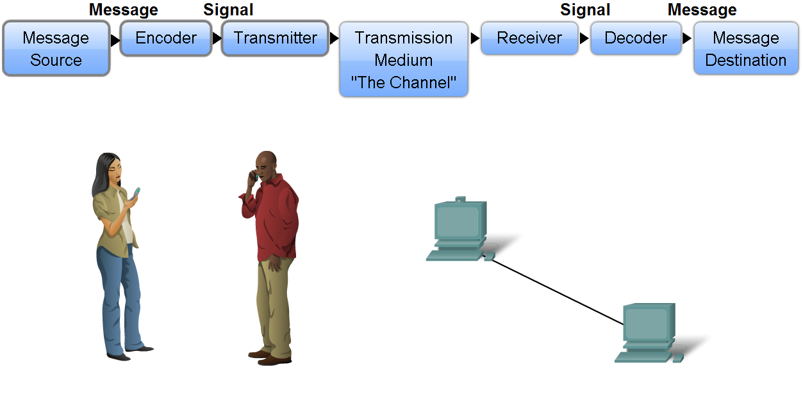
Network Structure
Define the elements of communication
  3 common elements of communication
    Message source
    The channel
    Message destination
Define a network
  Data or information networks capable of carrying many different types of communications

Slide 4
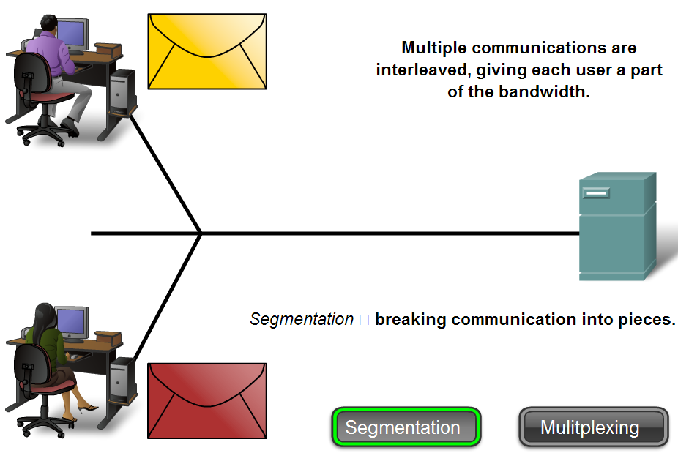
Network Structure
Describe how messages are communicated
  Data is sent across a network in small “chunks” called segments

Slide 5
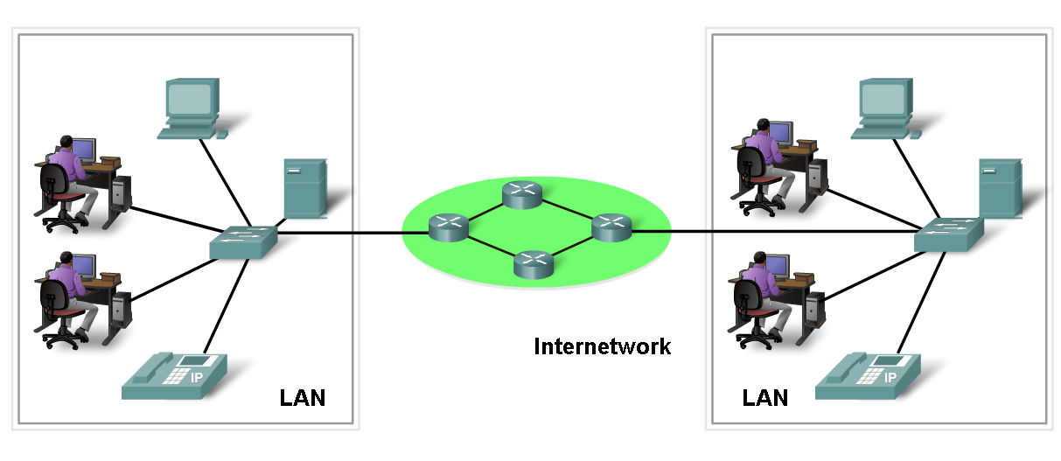
Network Structure
Define the components of a network
  Network components
    Hardware
    Software

Slide 6
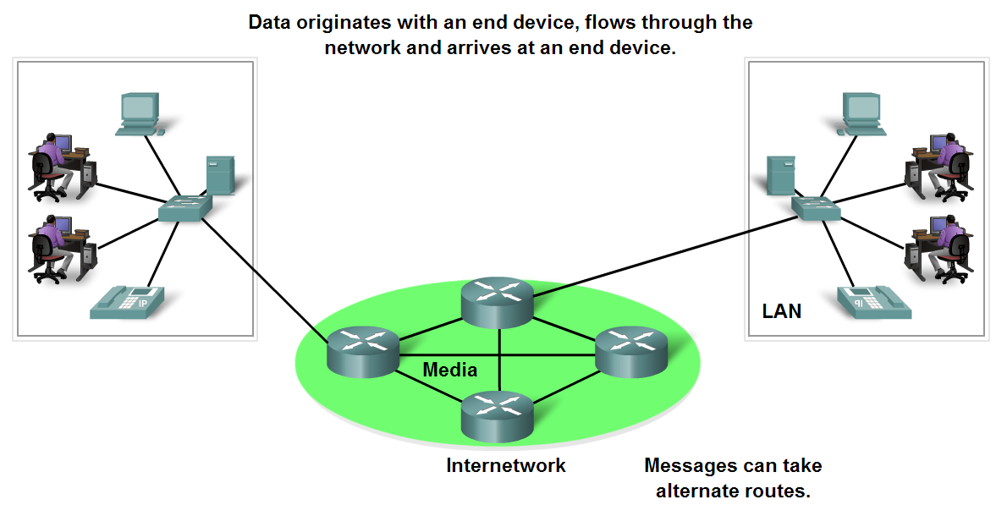
Network Structure
End Devices and their Role in the Network
  End devices form interface with human network & communications network
  Role of end devices:
    Client
    Server
    Both client and server

Slide 7
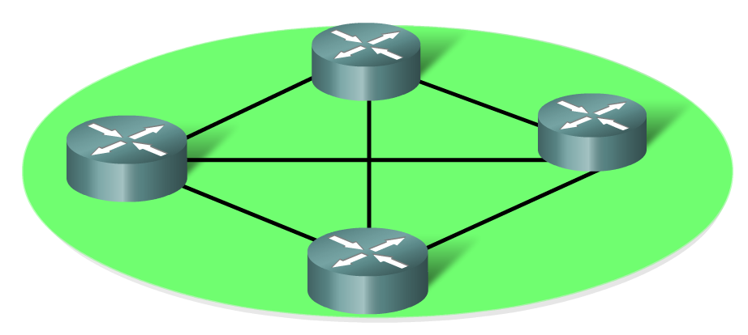
Network Structure
Identify the role of an intermediary device in a data network and be able to contrast that role with the role of an end device
  Role of an intermediary device
    Provides connectivity and ensures data flows across network

Slide 8
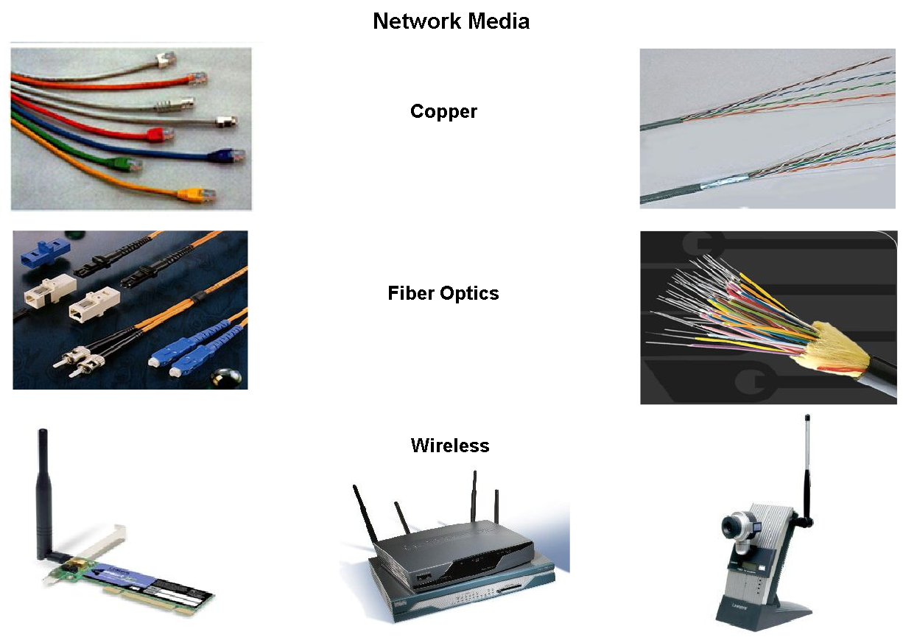
Network Structure
Define network media and criteria for making a network media choice
  Network media – this is the channel over which a message travels

Slide 9
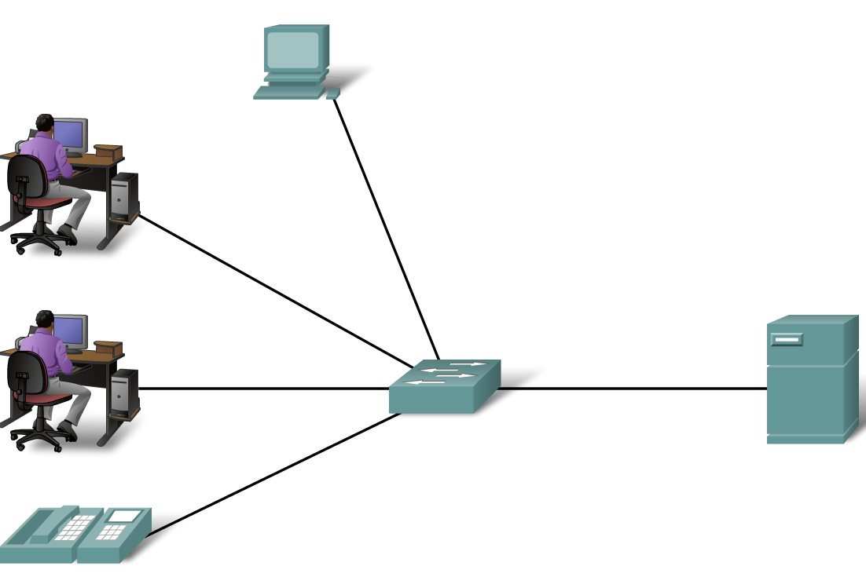
Network Types
Define Local Area Networks (LANs)
  A network serving a home, building or campus is considered a Local Area Network (LAN)

Slide 10
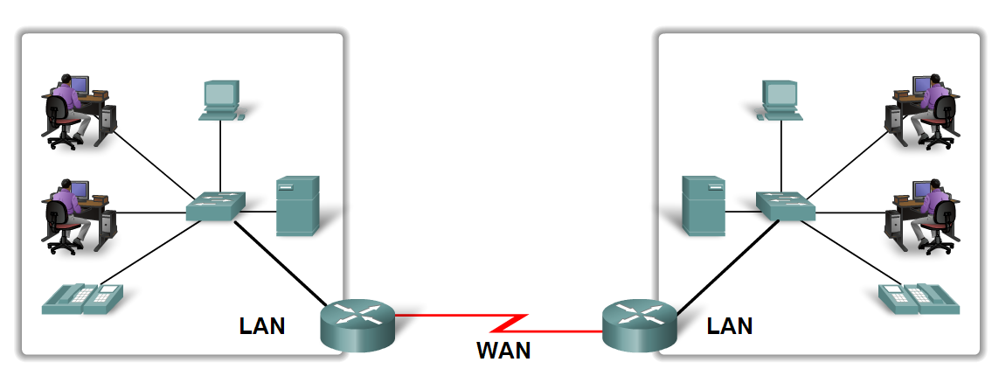
Network Types
Define Wide Area Networks (WANs)
  LANs separated by geographic distance are connected by a network known as a Wide Area Network (WAN)

Slide 11
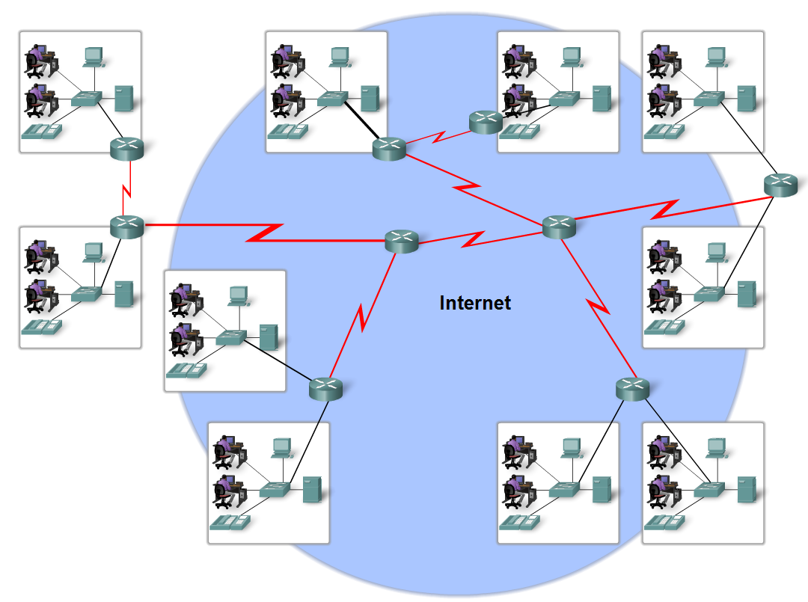
Network Types
Define the Internet
  The internet is defined as a global mesh of interconnected networks

Slide 12
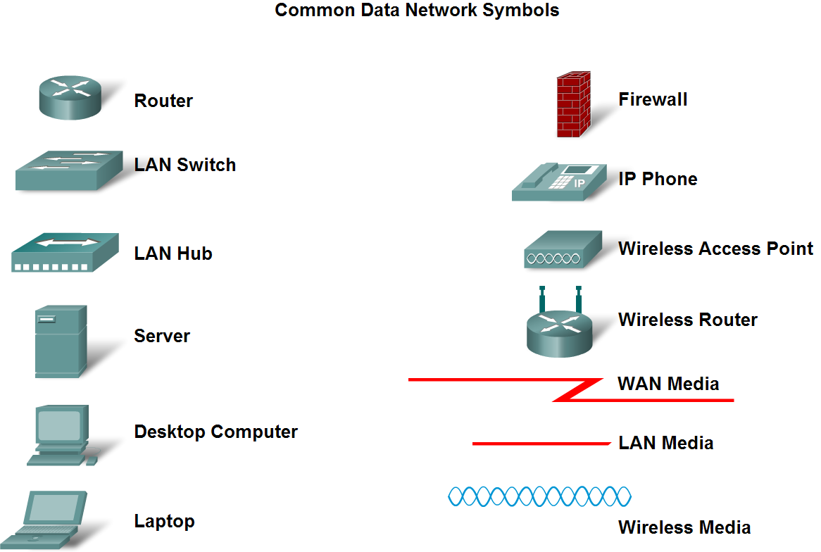
Network Types
Describe network representations

Slide 13
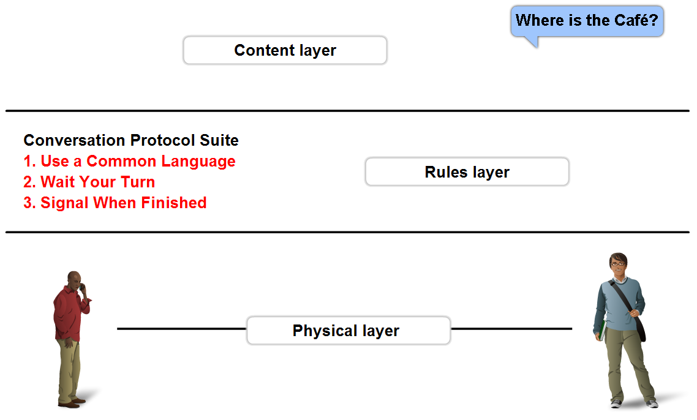
Function of Protocol in Network Communication
The importance of protocols and how they are used to facilitate communication over data networks
  A protocol is a set of predetermined rules

Slide 14
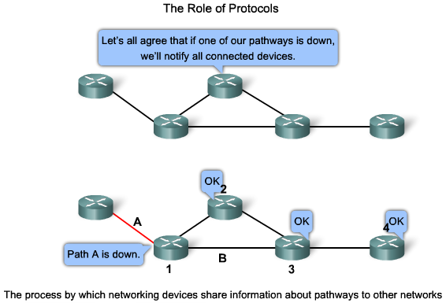
Function of Protocol in Network Communication
Explain network protocols
  Network protocols are used to allow devices to communicate successfully

Slide 15
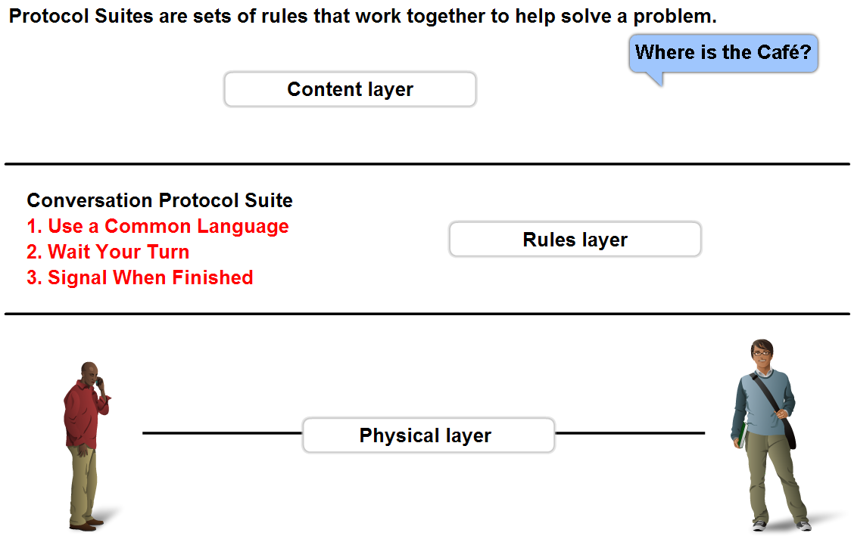
Function of Protocol in Network Communication
Describe Protocol suites and industry standards
  A standard is a process or protocol that has been endorsed by the networking industry and ratified by a standards organization

Slide 16
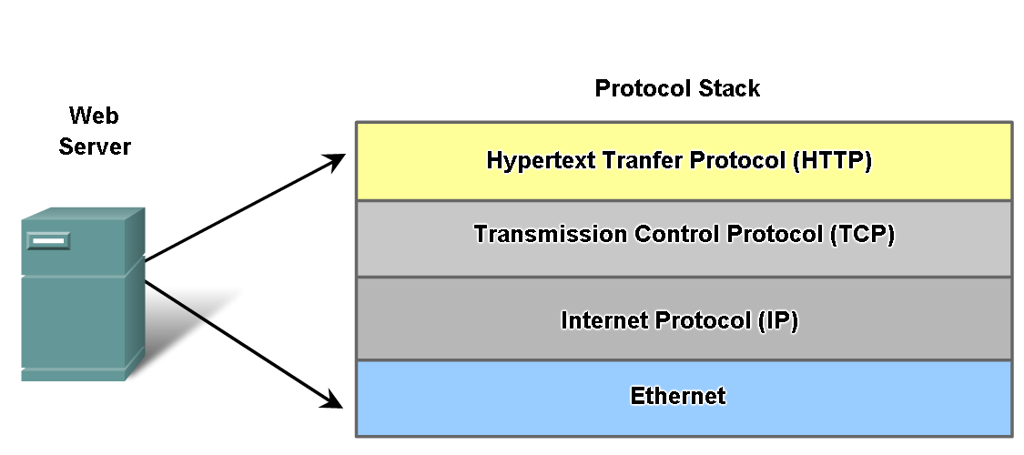
Function of Protocol in Network Communication
Define different protocols and how they interact

Slide 17
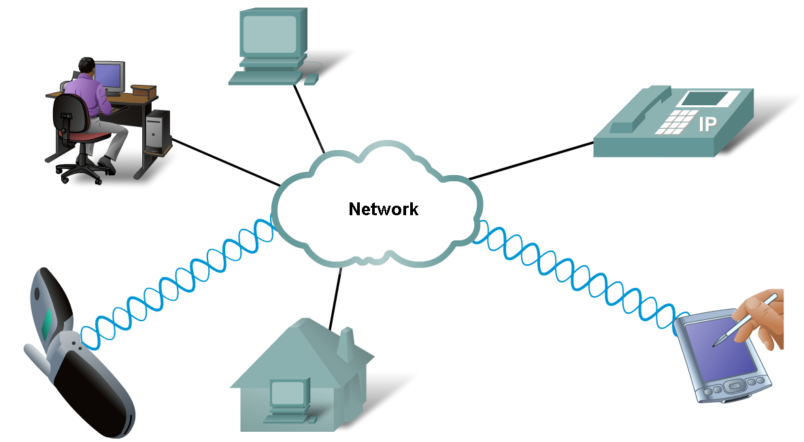
Function of Protocol in Network Communication
Technology independent Protocols
  Many diverse types of devices can communicate using the same sets of protocols
  This is because protocols specify network functionality, not the underlying technology to support this functionality

Slide 18
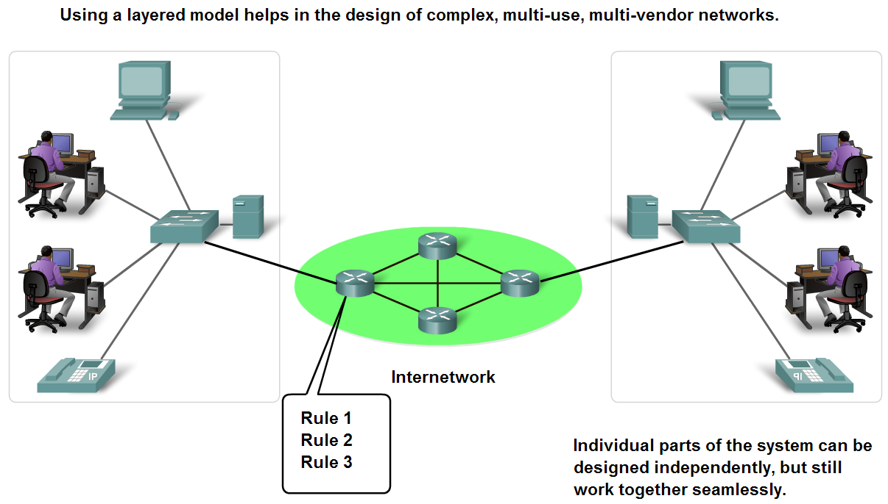
Layers with TCP/IP and OSI Model
Explain the benefits of using a layered model
  Benefits include
    Assists in protocol design
    Fosters competition
    Changes in one layer do not affect other layers
    Provides a common language

Slide 19
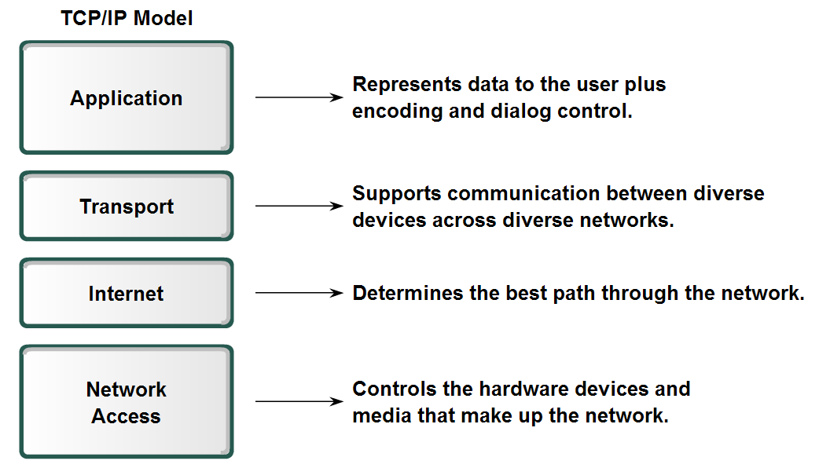
Layers with TCP/IP and OSI Model
Describe TCP/IP Mode

Slide 20
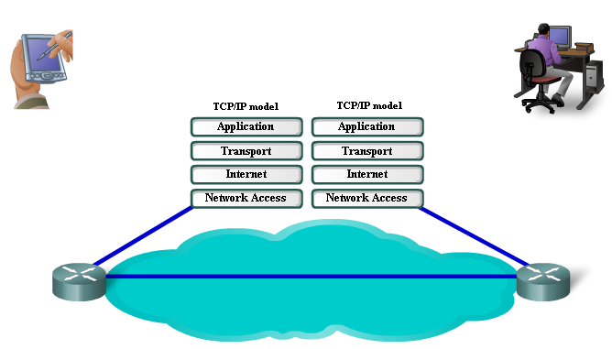
Layers with TCP/IP and OSI Model
Describe the Communication Process

Slide 21
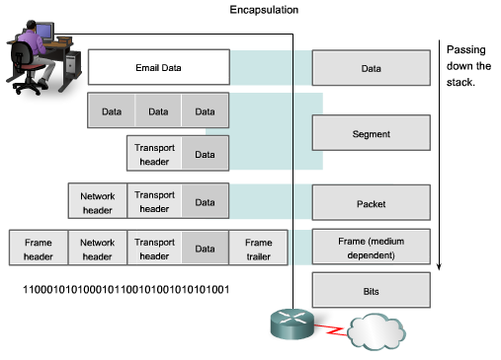
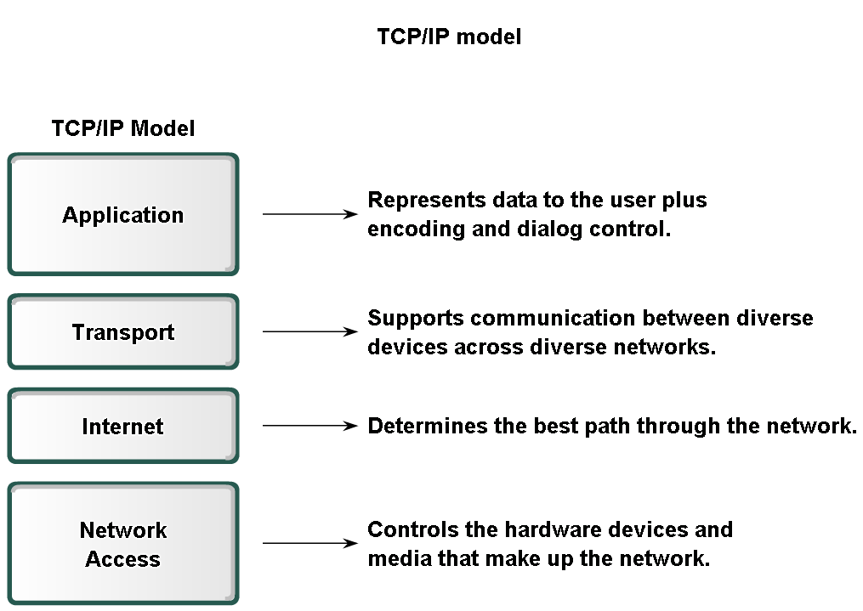
Layers with TCP/IP and OSI Model
Explain protocol data units (PDU) and encapsulation

Slide 22
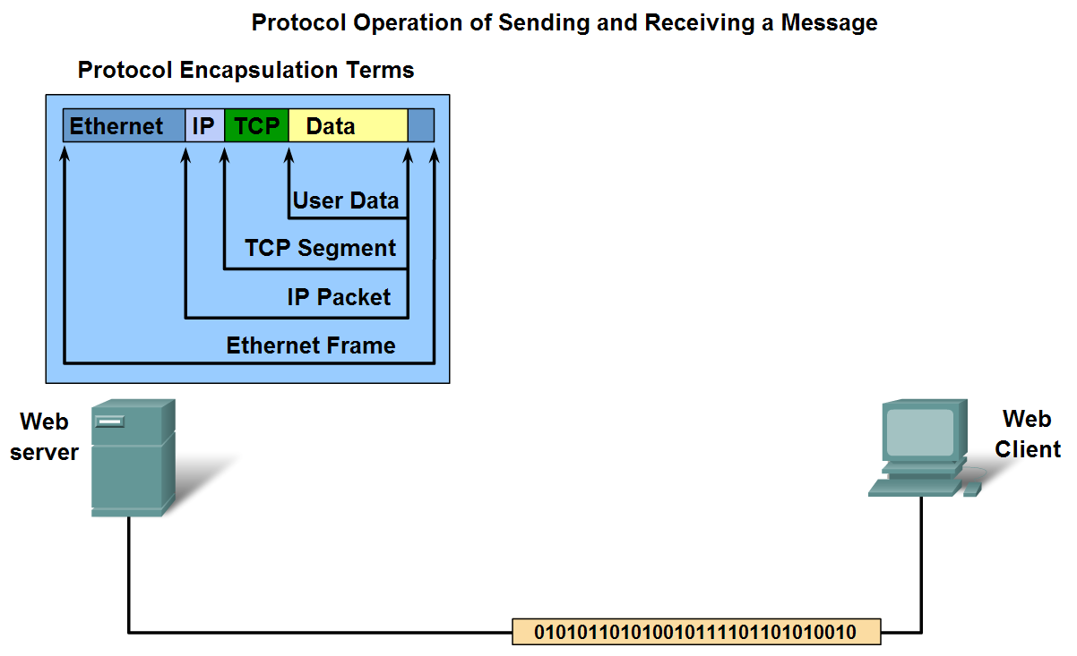
Layers with TCP/IP and OSI Model
Describe the process of sending and receiving messages

Slide 23
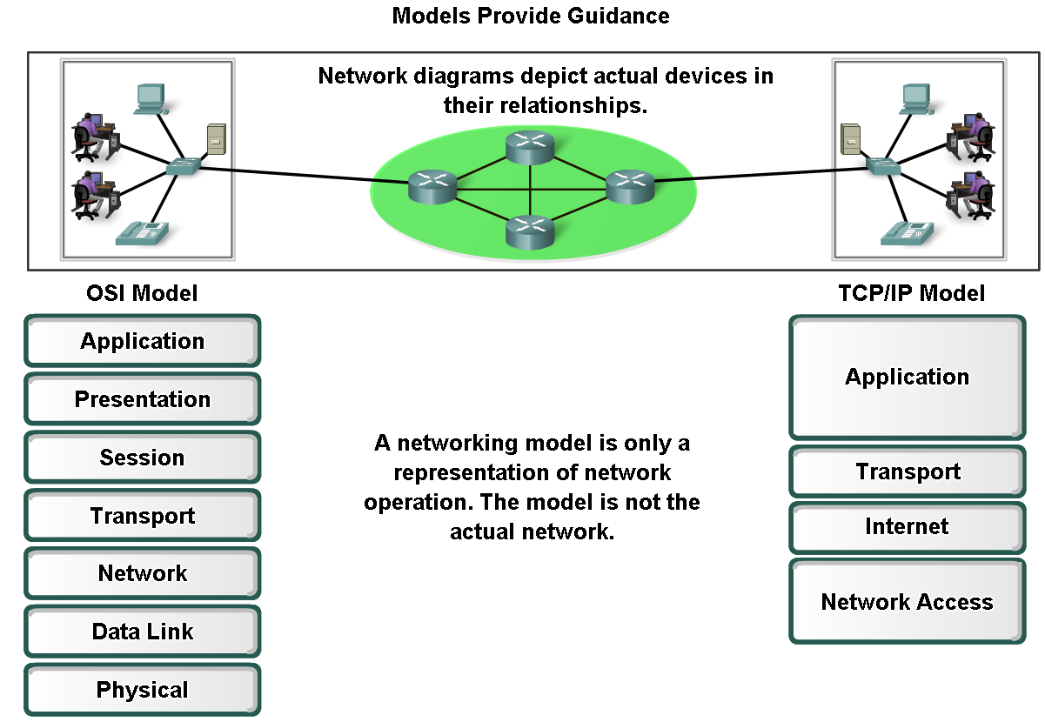
Layers with TCP/IP and OSI Model
Explain protocol and reference models
  A protocol model provides a model that closely matches the structure of a particular protocol suite
  A reference model provides a common reference for maintaining consistency within all types of network protocols and services

Slide 24
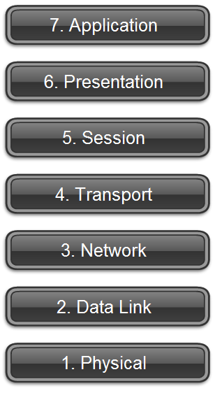
Layers with TCP/IP and OSI Model
Define OSI

Slide 25
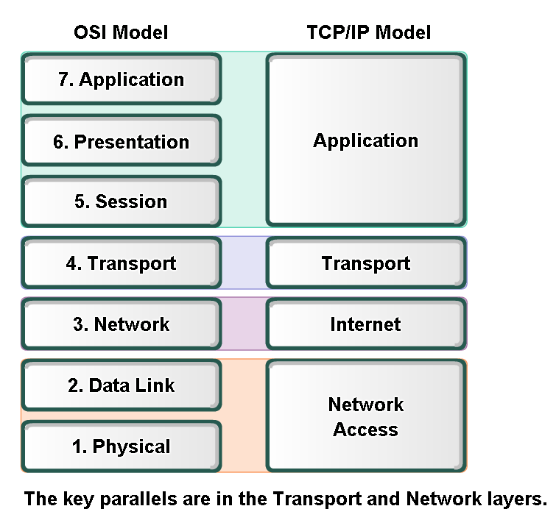
Layers with TCP/IP and OSI Model
Compare OSI and TCP/IP model

Slide 26
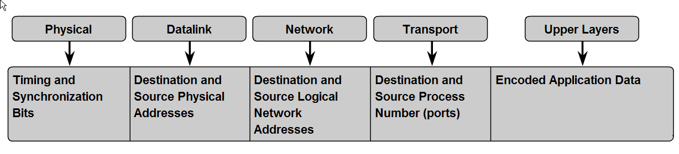
Addressing and Naming Schemes
Explain how labels in encapsulation headers are used to manage communication in data networks

Slide 27
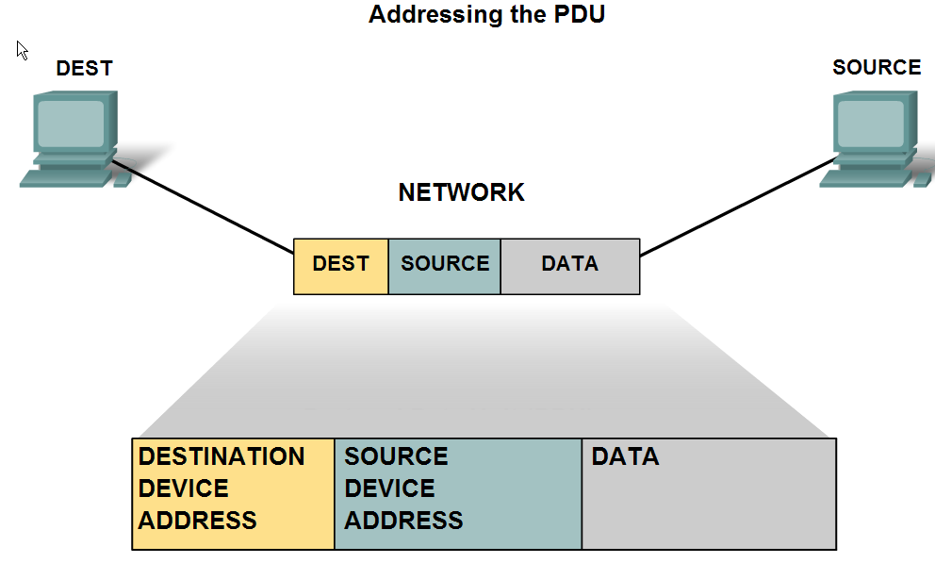
Addressing and Naming Schemes
Describe examples of Ethernet MAC Addresses, IP Addresses, and TCP/UDP Port numbers

Slide 28
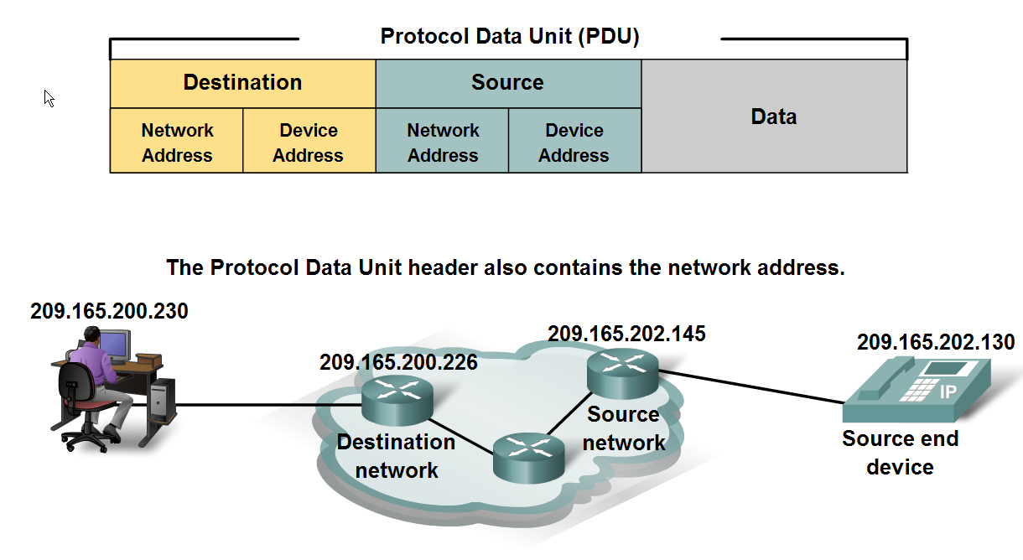
Addressing and Naming Schemes
Explain how labels in encapsulation headers are used to manage communication in data networks

Slide 29
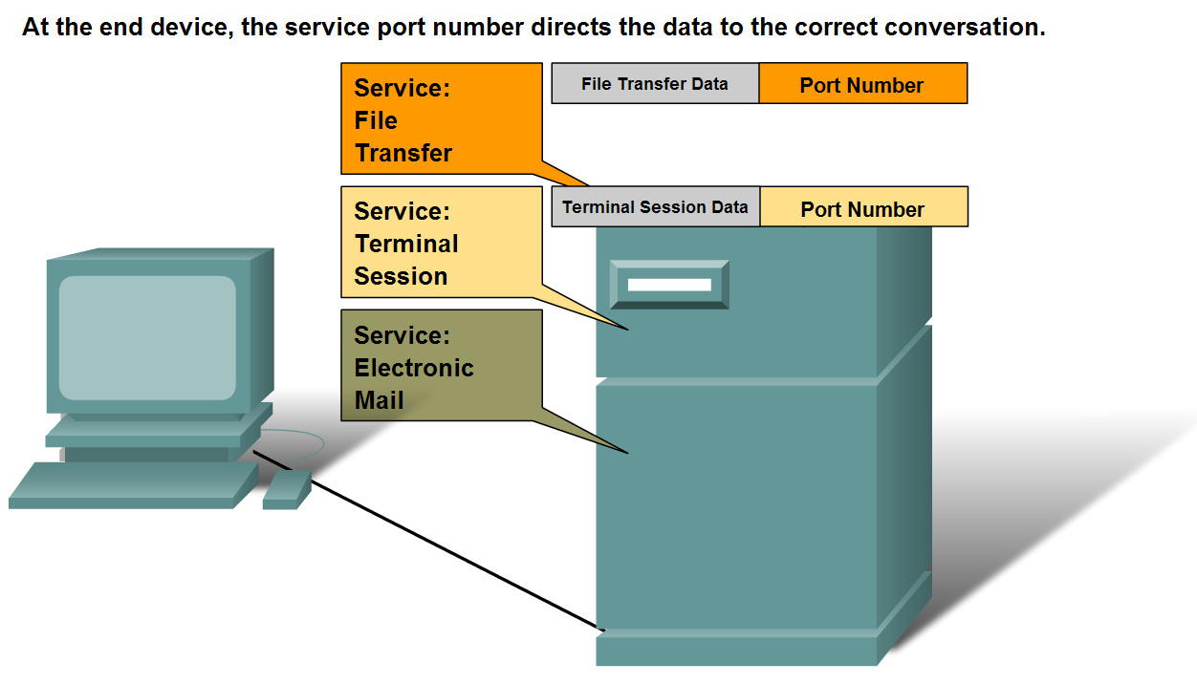
Addressing and Naming Schemes
Describe how information in the encapsulation header is used to identify the source and destination processes for data communication

Slide 30
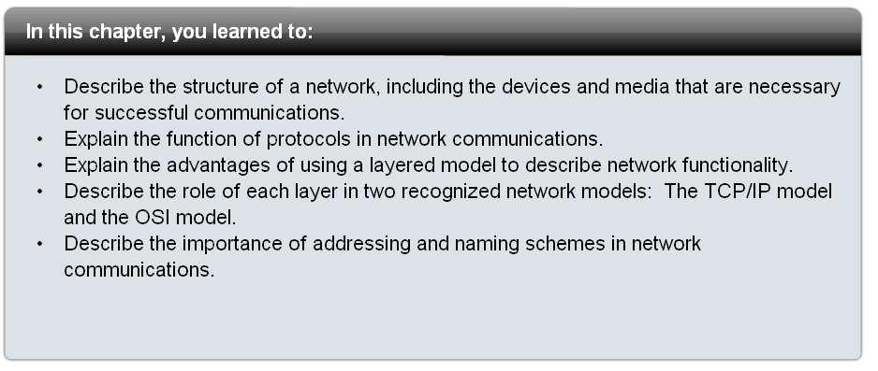
Summary

